Slide 1


Phi-4-Mini
Technical Report

Slide 2
Topic
Phi-4-Mini
  About
  Multi Head Self Attention
  Feed Forward Layer
  RMSNorm
  Architecture
Phi-4-Mini-Multimodal
  About
  Architecture

Slide 3
Phi-4-Mini
Carefully curated and synthesized data enables Small Language Models (SLMs) to achieve highly competitive performance despite having a significantly smaller number of parameters.
Compact (3.8 Billion parameter ), highly capable language model
Expanded Vocabulary size of 200064 to support multilingual application
32 Transformer layers with hidden size of 3072
Tied input and output embedding, reduces memory consumptions
24 Query head and 8 key/value head
Group query attention for efficient long sequence generations
Trained on high-quality web and synthetic data, significantly outperforming recent open-source models of similar size and matching the performance of models twice its size
Support 128K context length

Slide 4
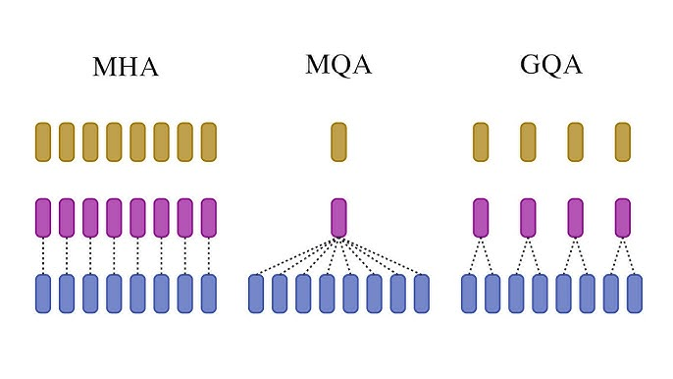
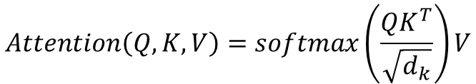
Multi-head self attention
………
Split into heads
Group Query Attention
Value
Value
Value
Value
Key
Key
Key
Key
Key
Value
Query 1
Query 2
Query 3
Query 24
Query
Concatenate output of all head
$$Attention\left(Q,K,V\right)=softmax\left(\frac{QK^{T}}{\sqrt{d_{k}}}\right)V$$
Out projection [3072 x 3072]

Slide 5
Multi-head self attention
………
Split into heads
5120
To QKV [3072 x 5120]
3072
2048
GROUP 1
GROUP 8
Key
Head 1
Value
Key
Value
1024
1024
24 Query
8 Key
8 Value
Query 1
Query 2
Query 3
Query 22
Query 23
Query 24
128
128
128
128
Reducing KV cache consumption to one third of its standard size
Fractional RoPE dimension is used (25% remains position agnostic)
Concatenate output of all head
Out projection [3072 x 3072]

Slide 6
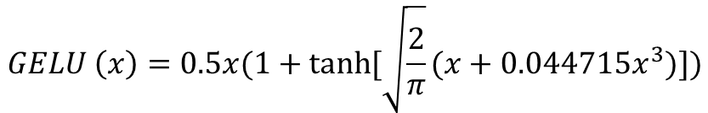
Feed Forward Network
$$GELU \left(x\right)=0.5x(1+tanh⁡[\sqrt{\frac{2}{π}}(x+0.044715x^{3})])$$
Gate up projection [3072 x 16384]
Element wise multiplication
8192
8192
GELU Activation
8192
Gate Down projection [8192 x 3072]

Slide 7

Let’s say we have an input vector x of dimension d.
Step 1 ) Compute the Root Mean Square (RMS)
$RMS= \sqrt{\frac{1}{d}\sum_{i=1}^{d}{x_{1}^{2}} +ε }$
Step 2 ) Normalize the Input
${\hat{x}}_{i}= \frac{x_{i}}{RMS(x)}$
Step 3 ) Apply Learnable Scale Parameters ($γ$)
$RMSnorm\left(x_{i}\right)= γ_{i}{.x}_{i}$
RMSNorm (Root Mean Square Layer Normalization)

Slide 8
Tokenizer
Embedding
200064 x 3072
Transformer
Block
RMS Norm
Architecture
Multi-head self attention
32x
RMS Norm
Feed Forward
LM Head

Slide 9
Phi-4-Mini-Multimodal
Multimodal model integrates text, vision and speech/audio input modalities into a single model
Its Novel (Mixture of LoRAs) modality extension approach leverages LoRA adapters and modality-specific routers to allow multiple inference modes combining various modalities without interference
Keeps base model entirely frozen
It allows seamless integration of new LoRAs to support additional modalities without impacting existing one
First open-source model with speech summarization capability

Slide 10
Vision Modality
Vison Encoder (SigLip-400M)
1152
Vision Projector
A vision projector (2-layer MLP ) to align the vision and text embeddings
Vision encoder is finetuned with LLM2CLIP on large scale image text pairs
Extra LoRA is added on all the linear layers in the language decoder
Vison encoder and projector introduce 440 M model parameter while vision adapter LoRA consume 370M parameter
3072
Transformer
Block
RMS Norm
Multi-head self attention
256 Rank
Vision Adapter LoRA
RMS Norm
256 Rank
Feed Forward
LM Head

Slide 11
Speech and Audio Modality
Audio Encoder
1024
Audio Projector
Audio projector (2-layer MLP ) to align the audio and text embeddings
Extra LoRA is added on all the linear layers in the language decoder
Audio encoder and projector introduce 460 M model parameter while vision adapter LoRA consume 460M parameter
3072
Transformer
Block
RMS Norm
Multi-head self attention
320 Rank
Audio Adapter LoRA
RMS Norm
320 Rank
Feed Forward
LM Head

Slide 12
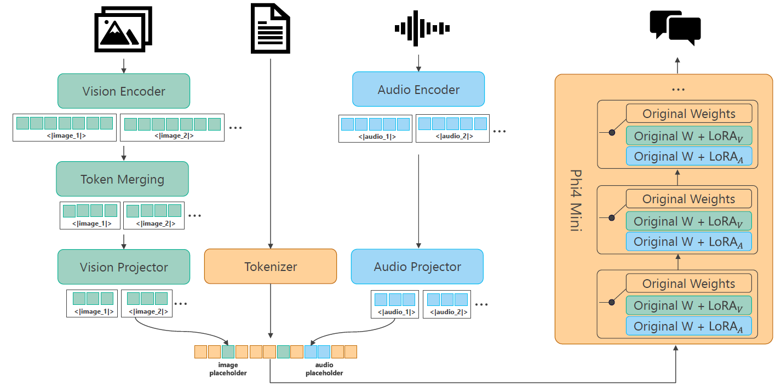
Phi 4 Mini Multimodal

Slide 13
Training
Training process comprises multiple stages, including language training (encompassing both pretraining and post-training) and then expansion of the language backbone to vision and speech/audio modalities.
Once the language model training is complete, freeze the language model and implement “Mixture of LoRAs” technique to proceed with the multimodal training stage.
Vision Training
Projector Alignment Stage (caption data, projector )
Joint Vision Training Stage (Vision dataset, Vision encoder, projector)
Generative Vision Language stage (Vision Language dataset, Vision encoder, projector, LoRAv)
Multi Frame Training Stage (Multi Frame SFT data , Vision encoder Frozen)

Slide 14
Speech and Audio Training
Audio/Speech Pre-training (ASR data, encoder, projector)
Audio/Speech Post-training (LoRAa, audio projector, audio encoder frozen)
Vision-Speech Joint Training
Freeze audio encoder and audio projector, while finetuning LoRAv, vision encoder and vision projector. Train on vision-speech SFT dataset

Slide 15

Thank you

